Slide 1
AWS – Design & VPC
VishwanaTH m s
VISHWACLOUDLAB.com

Slide 2
Agenda
Regions and Availability Zone
Create Custom Network

Slide 3
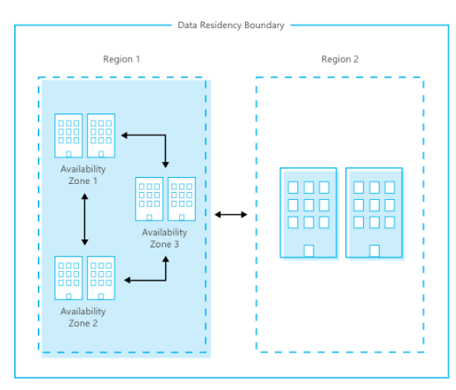
Concepts of Region and Availability Zone
Each region has min of 2 (Availability Zone) and max of 6 AZ.
Total of 84 Availability Zone and each Availability Zone could have multiple Datacenter
Each Availability Zone are interconnected with HIGH BANDWIDTH (BACKHOLE LINK, more than 1000Gbps)
Each Region is also connected with other region. (The speed might be less when compared to above).
REGION IS NOT EQUAL TO COUNTRY

Slide 4
Concepts of Region and Availability Zone
AWS has 22 regions , out of which 3 are China Regions, which are not accessible.
https://aws.amazon.com/about-aws/global-infrastructure/regions_az/
Each region has min of 2 (Availability Zone) and max of 6 AZ.
Total of 69 Availability Zone and each Availability Zone could have multiple Datacenter
Each Availability Zone are interconnected with HIGH BANDWIDTH (BACKHOLE LINK, more than 1000Gbps)
Each Region is also connected with other region. (The speed might be less when compared to above).
REGION IS NOT EQUAL TO COUNTRY

Slide 5
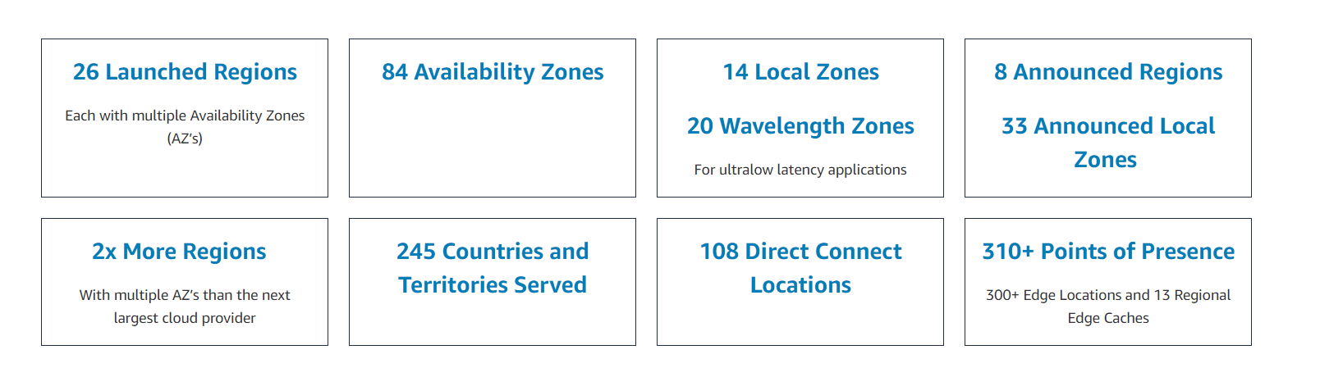
Concepts of Region and Availability Zone
AWS has 26 regions , out of which 3 are China Regions, which are not accessible.
https://aws.amazon.com/about-aws/global-infrastructure/regions_az/

Slide 6
Concepts of Region and Availability Zone
AWS has 25 regions , out of which 3 are China Regions, which are not accessible.
Each region has min of 2 (Availability Zone) and max of 6 AZ.
Total of 69 Availability Zone and each Availability Zone could have multiple Datacenter
Each Availability Zone are interconnected with HIGH BANDWIDTH (BACKHOLE LINK, more than 1000Gbps)
Each Region is also connected with other region. (The speed might be less when compared to above).
REGION IS NOT EQUAL TO COUNTRY

Slide 7
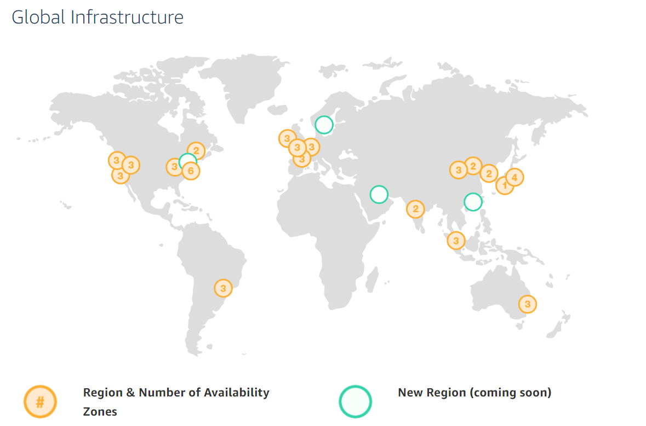

Slide 8
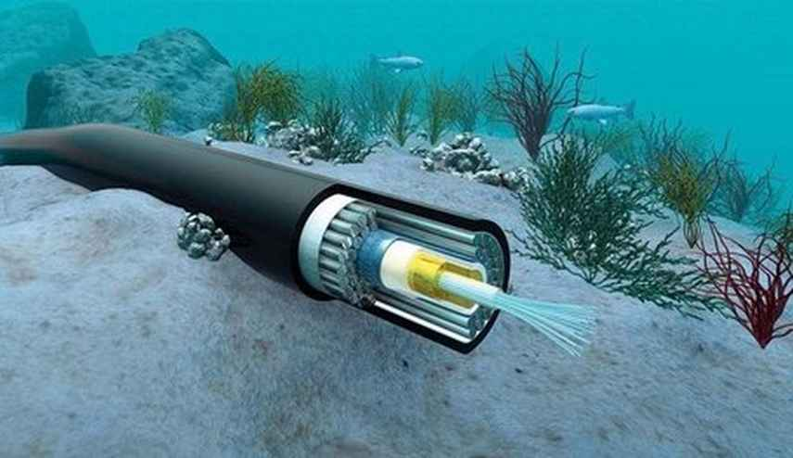

Slide 9
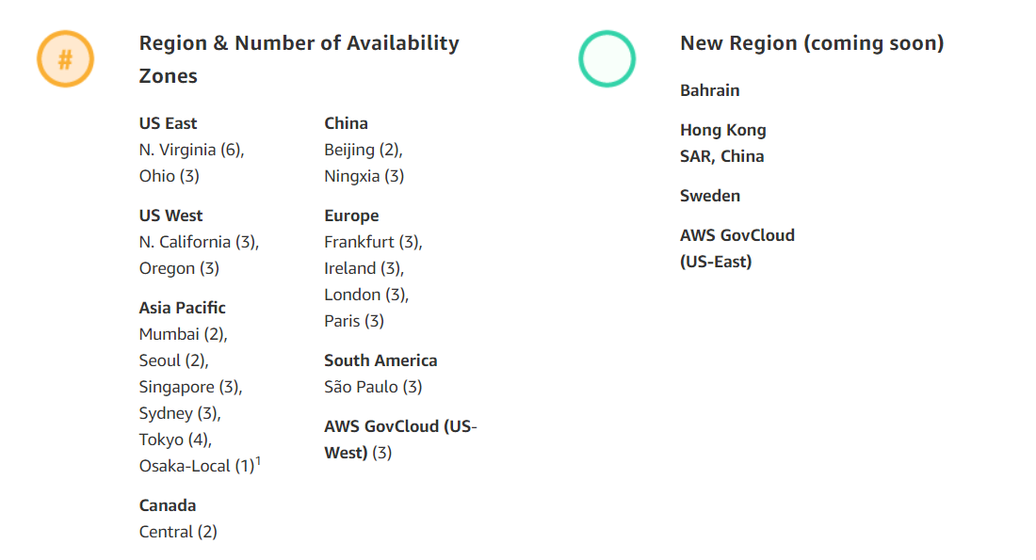
List of Region and AZ count

Slide 10
Creation of VPC (Basic networking)
Basic Four Steps to create an basic Network platform for your Virtual Datacenter.
Create a VPC
Create Subnet
Create Internet Gateway
Modify/update Routing Table.

Slide 11
Subnetting – Example – 192.168.0.0/18 60 IP’s per network, 6 Network
Example - 3
Solution:
60 ~ 2^6, No of new H bit = 6, No of New N bit = 32 -6 =26
192.168.0.0/26 H
192.168.00000000.00000000/26→ 192.168.0.0/26 – 1st Subnetwork
+1
192.168.00000000.01000000/26 → 192.168.0.64/26 – 2nd Subnetwork
+1
192.168.00000000.10000000/26 → 192.168.0.128/26 – 3rd Subnetwork
+1
192.168.00000000.11000000 /26 → 192.168.0.192/26 – 4th Subnetwork
+1
192.168.00000001.00000000/26→ 192.168.1.0/26 – 5th Subnetwork
+1
192.168.00000001.01000000/26→ 192.168.1.64/26 – 6th Subnetwork
192.168.00111111.11000000/26 → 192.168.63.192/26 – Last Subnetwork
0 + 0 = 0
0 + 1 = 1
1 + 0 = 1
1 + 1 = 10
2^7 2^6 2^5 2^4 2^3 2^2 2^1 2^0
128 64 32 16 8 4 2 1

Slide 12
Architecture of VPC and Subnet
Internet
Within the VPC communication
Internet Gateway
192.168.0.0/20
VPC / Virutal Router
192.168.1.0/24
Subnet1
Subnet2
192.168.2.0/24
Default Route Table:
Local network of VPC
No route to internet
VM01
VM02
VM03
VM04

Slide 13
Concepts VPC
VPC is the Base for all the connectivity's inside your Virtual Datacenter on AWS.
VPC is part of one region only.
By Default 2 different VPC’s DOES not talk to each other
All the Network’s Within the same VPC can talk to each other.
An Subnet can be part of “1” VPC only with assigned to “1” AZ only.

Slide 14
Step1 : Creation of VPC
By default in an account, all the Regions has an Default VPC created by AWS With “172.31.0.0/16”
Also default “Subnets” are created for these VPC’s in the Regions, eg:-- “172.31.0.0/20”
We should be creating VPC with “IPV4 Private IP” ranges only.
Private IPV4
10.0.0.0 to 10.255.255.255
172.16.0.0 to 172.31.255.255
192.168.0.0 to 192.168.255.255
100.64.0.0 to 100.127.255.255
Select a VALID NETWORK FOR VPC CIDR

Slide 15
After Creation of VPC
An VPC ID is created.
IPv6 public address block is assigned by AWS to your VPC (if enabled)
By default the public network would be “/56” Network.
Default DHCP option Set gets assigned.
DNS Resolution is by default “yes”. This helps all the VM’s In the VPC to resolve any “Name” to “ip address”.
DNS Hostname is by default “No”. Change it to “yes”, this helps to provide an public DNS hostname to your VM’s.
Default Routing Table gets created.
Default Network ACL gets created. → By default all the Traffic Inbound and Outbound are ALLOWED.
Note:-- NACL – Network Access Control List
We can add “Main Network” to the same VPC.

Slide 16
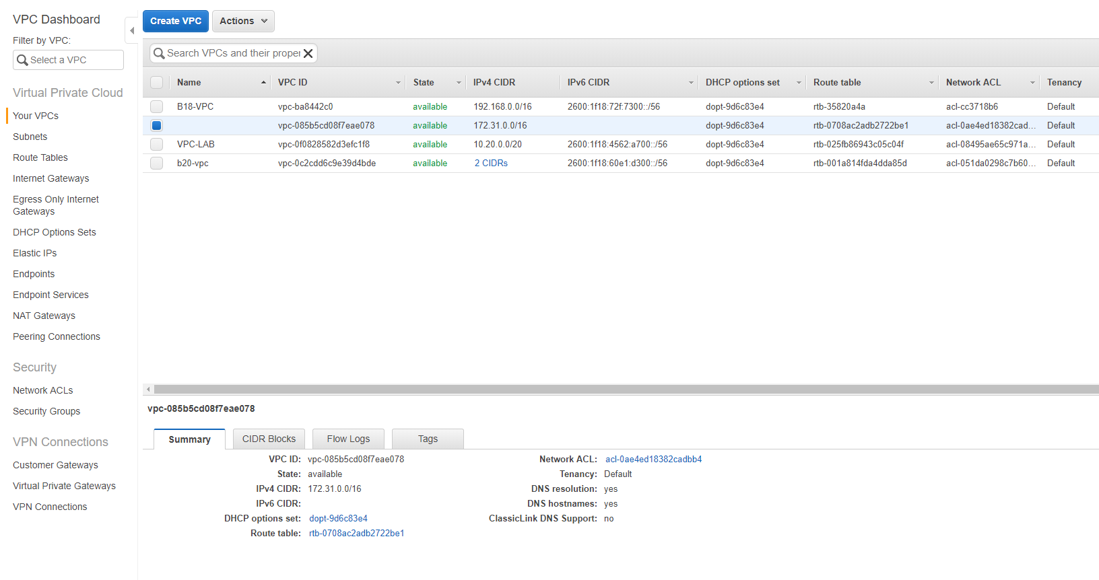

Slide 17
Creation of VPC (Basic networking)
Basic Four Steps to create an basic Network platform for your Virtual Datacenter.
Create a VPC
Create Subnet
Create Internet Gateway
Modify/update Routing Table.

Slide 18
Step2: Creation of Subnet
After manual Subnetting of the VPC CIDR, we would be creating the Subnets.
Select the Appropriate “VPC”
Assign the “CIDR” for the Subnet. (Means the Subnetwork)
Assign the Availability Zone ( Datacenter)
Eg: -- “Us-east-1” refers to N.Virginia and “a” to “f” refers to the Datacenters available in that Region.
SUBNET CANNOT BE CHANGED TO A DIFFERENT AVAILABILITY ZONE AFTER CREATION OF IT.
Allocated IPv6 from the given ::/64 Network.

Slide 19
After Creation of Subnets
Subnet ID is created.
if IPv6 was enabled, each Subnet get “/64” subnet network from the main Network assigned in the VPC.
Each subnet has “5” Ip’s blocked for AWS usage.
The First IP is the Network ID, eg:-- 172.30.1.0/24
The Second IP is the First usable IP also called as Default Gateway for the subnet: 172.30.1.1/24
The Last IP is the Broadcast, eg:-- 172.30.1.255/24
There are 2 more IP’s , that are used internally by the “Virtual Router” for Failover.
Note: -- VPC’s one of the function is “Virtual Router”

Slide 20
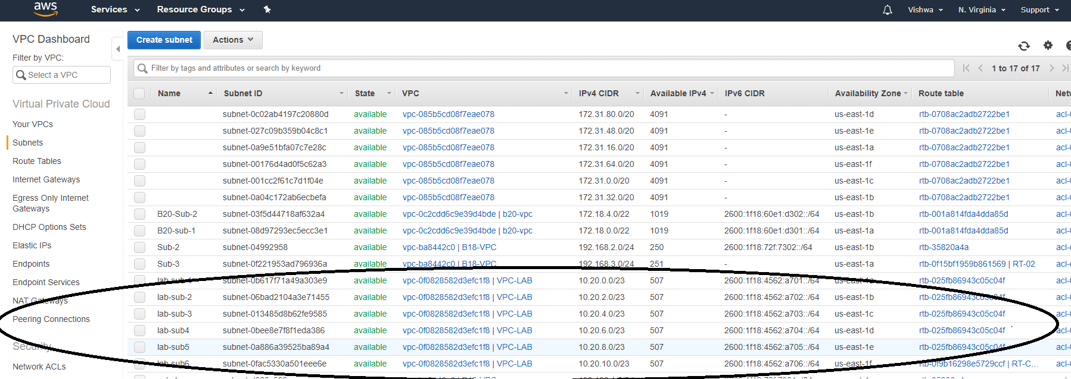

Slide 21
Architecture of VPC and Subnet
VPC / Router
Subnet1
Subnet2
Default Route Table:
Local VPC network
No route to internet
VM01
VM02
VM03
VM04

Slide 22
Architecture of VPC and Subnet
VPC / Router
Subnet1
Subnet2
Default Route Table:
Local VPC network
No route to internet

Slide 23
Creation of VPC (Basic networking)
Basic Four Steps to create an basic Network platform for your Virtual Datacenter.
Create a VPC
Create Subnet
Create Internet Gateway
Modify/update Routing Table.

Slide 24
Step3: Creation of Internet Gateway
Internet Gateway is created to intimate VPC that it would have internet connection
Its just an Interface that gets created on the VPC
After creating the Internet Gateway, we would need to Attach it to an VPC.
Note:-- ONE VPC CAN HAVE ONLY ONE INTERNET GATEWAY

Slide 25
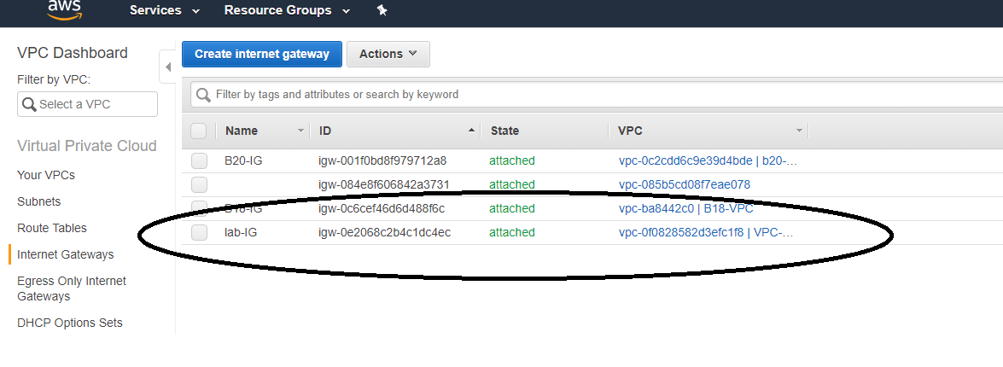

Slide 26
Architecture of VPC and Subnet
Internet
Internet Gateway
VPC / VPCName
Subnet1
Subnet2
Default Route Table:
Local VPC network
No route to internet
VM01
VM02
VM03
VM04

Slide 27
Creation of VPC (Basic networking)
Basic Four Steps to create an basic Network platform for your Virtual Datacenter.
Create a VPC
Create Subnet
Create Internet Gateway
Modify/update Routing Table.

Slide 28
Step4: Modify the Route Table
Properties of the Routing Table
All the Subnets are by default part of the Default Routing Table for that VPC.
By default, all the Private Network and the IPv6 Public Network assigned by AWS is part of the Routing table
By Default, there is NO route for the Internet Traffic.
Custom Route Table does not have any Subnets Associated to it by DEFAULT.
We need to manually add the route for Internet Traffic.
For IPv4 “0.0.0.0/0” is added for allowing all Traffic towards Internet (Bi-Directional)
For IPv6 “::/0” is added for allowing all Traffic towards Internet (Bi-Directional)

Slide 29
How did the 0.0.0.0/0 come?
192.168.1.0/24
- first 3 octet are fixed and 4th octet can take any value.
192.168.0.0/16
- first 2 octet are fixed and next 2 octet can take any value.
192.0.0.0/8
- first octet is fixed and next 3 octet can take any value.
0.0.0.0/0
- All the octet can take any value – ALL TRAFFIC – DEFAULT ROUTE

Slide 30
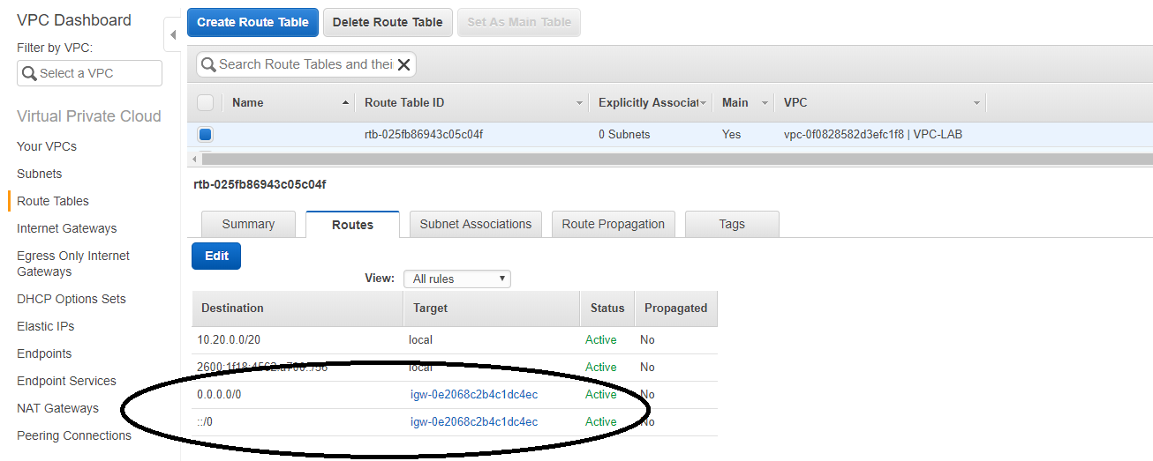

Slide 31

VPC – Demo – Setup - Details
Internet
Gateway
VPC-1 → Region – east US
Internet
172.18.0.0/16 – VPC Network -1
Sub1-1
172.18.1.0/24
Sub2-1
172.18.2.0/24
VM-01
LInux
Us-east-1a
Us-east-1b
EAST US
Add routing entry on VPC-1 routing table
0.0.0.0/0 – Internet Gateway
::/0 – Internet Gateway

Slide 32
Hurrey….
NOW CREATE AN BASIC VIRTUAL MACHINE(EC2) AND YOU ARE DONE WITH THE VM ON THE CLOUD WITH INTERNET ACCESS.

Slide 33
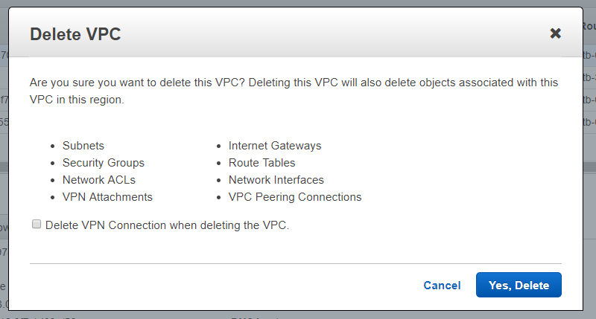
Deleting VPC

Slide 34
Troubleshooting VPC
Basic Troubleshooting steps if the EC2 instance is not getting connected.
Check Weather “Internet gateway” is created an assigned to “Routing Table”.
If custom Route table created, weather “Subnet’s” are associated to the new Routing table.
Weather “PORTS” are allowed in the security group for “inbound” and “outbound”.
https://aws.amazon.com/premiumsupport/knowledge-center/troubleshoot-vpc-route-table/

Slide 35


